Slide 1
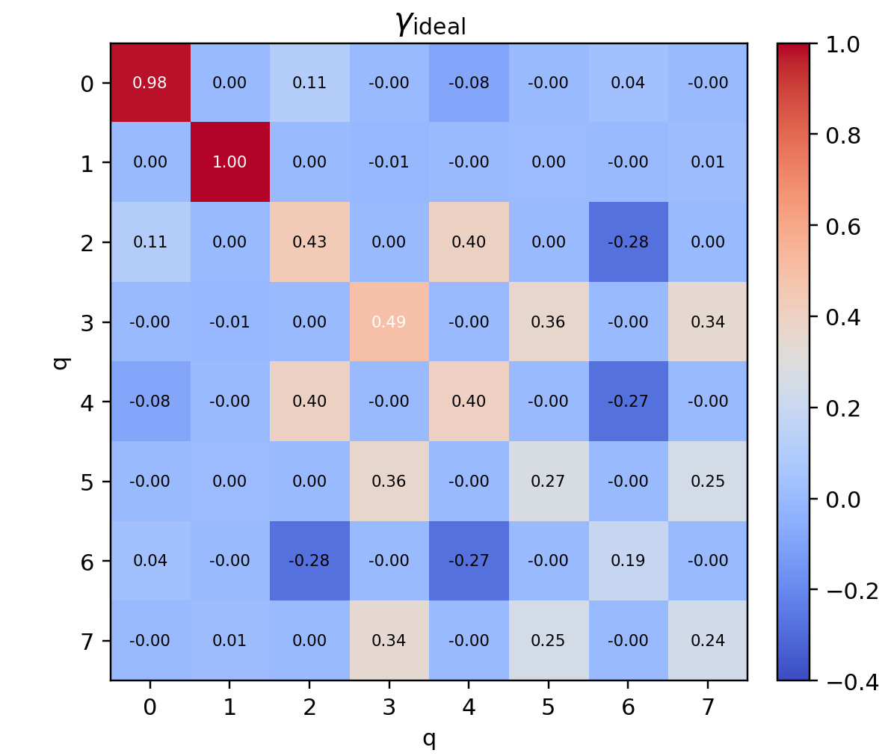
COURSE PRESENTATION · NEW-DATA EDITION
From Hartree–Fock to an H₈ Quantum Reproduction
Connecting orbital rotations, quantum measurements, energy, and diagnostics through the 1‑RDM
H
H
H
H
H
H
H
H
Linear H₈ · orbitals/modes 0…7
HF → Givens → 1‑RDM → H₈
01
Notes:
This edition keeps the Hartree-Fock and 1-RDM narrative unchanged and replaces the reproduction evidence with the newly supplied nine-setting dataset.
[Sources]
- User-supplied circuit_result.zip (nine JSON files, 2026-07-28).
- Reproducible local analysis: code/h8_reproduction.py; results/diagnostics.json.
- Rubin et al., Science 369, 1084–1089 (2020), Supplementary Material, Appendix C.

Slide 2
STORYLINE
Four sections, one computational chain
01
Background
HF optimizes orbitals on the single-Slater manifold
02
Theory
The 1‑RDM closes the 2‑RDM and determines the HF energy
03
Visualization
Heatmaps, occupations, and idempotency expose physicality
04
H₂ → H₈ reproduction
H₂: simulator/Wukong energy → H₈: nine-setting 1-RDM
STORYLINE
02
Notes:
Use this slide to establish the learning progression. Each section answers the question created by the previous one: what HF optimizes, what the quantum device measures, how to judge the output, and what the H8 data actually show.
[Sources]
- https://arxiv.org/abs/2004.04174
- https://quantumai.google/cirq/experiments/hfvqe

Slide 3
PART I · BACKGROUND
HF restricts the many-electron problem to one best determinant
$$\hat{H}=\sum_{p,q}^{​}{h_{pq}}a_{p}^{†}a_{q}+\frac{1}{2}\sum_{p,q,r,s}^{​}{g_{pqrs}}a_{p}^{†}a_{q}^{†}a_{s}a_{r}+E_{nuc}$$
1-RDM 2-RDM
Born–Oppenheimer freezes the nuclei
• $h_{pq}$: kinetic energy plus electron–nuclear attraction
• $g_{pqrs}$: electron–electron repulsion
• $E_{nuc}$: nuclear repulsion at fixed geometry
$$\left|Φ\left(C\right)\right\rangle =\prod_{i=1}^{N_{e}}{\left(\sum_{p}^{​}{C_{pi}}a_{p}^{†}\right)}\left|0\right\rangle$$
$$C=\left(C_{pi}\right)$$
$$\text{constraints}\text{: }CC^{†}=I_{n}$$
H
H
H
H
H
H
H
H
Linear H₈ · orbitals/modes 0…7
Cost: correlation beyond one determinant is absent
PART I · BACKGROUND
03
Notes:
Start from the Hamiltonian and name the three energy contributions. HF does not remove electron–electron interaction; it restricts the antisymmetric wavefunction to one determinant, retaining exchange but missing correlation.
[Sources]
- https://arxiv.org/abs/2004.04174
- https://pyscf.org/user/scf.html

Slide 4
PART I · BACKGROUND
The quantum module rotates orbitals; it does not optimize arbitrary 2⁸ amplitudes
$$E_{HF}=\min_{C^{†}C=I}⟨Φ\left(C\right)\left|\hat{H}\right|Φ\left(C\right)⟩$$
Classical integrals
Quantum orbital rotation
Classical contraction
geometry + basis
→ $h, g, E_{nuc}$
Givens mesh
→ $|Φ\left(C\right)⟩$
measured $γ$
→ $E_{HF}$
The qubit state may be strongly entangled in the computational basis, while the fermionic state remains a classically tractable Gaussian/Slater state.
PART I · BACKGROUND
04
Notes:
Emphasize the boundary of the quantum module. At half filling, H8 has 4×4=16 non-redundant occupied–virtual rotations, not 256 arbitrary state amplitudes.
[Sources]
- https://arxiv.org/abs/2004.04174

Slide 5
PART II · THEORY
The 1‑RDM links quantum measurements to the HF energy
$$γ_{pq}=⟨Φ\left|a_{p}^{†}a_{q}\right|Φ⟩$$
Four hard constraints for a pure Slater determinant
$γ^{†}=γ$
$Tr γ=N_{e}$
$0≼γ≼I$
$γ^{2}=γ$
Natural occupations: four ones + four zeros
PART II · THEORY
05
Notes:
Interpret the 1‑RDM as the projector onto the occupied subspace. Hermiticity and trace are easy to satisfy; the discriminating tests are the 0/1 spectrum and idempotency.
[Sources]
- https://arxiv.org/abs/2004.04174
- https://quantumai.google/cirq/experiments/hfvqe

Slide 6
PART II · THEORY
Wick closure makes the HF energy quadratic in the 1‑RDM
$$Γ_{pq,rs}=γ_{pr}γ_{qs}−γ_{ps}γ_{qr}$$
2-RDM is determined by 1-RDM!
$$E_{HF}=E_{nuc}+\sum_{p,q}^{​}{h_{pq}}γ_{qp}+\frac{1}{2}\sum_{p,q,r,s}^{​}{g_{pqrs}}\left(γ_{rp}γ_{sq}−γ_{sp}γ_{rq}\right)$$
Quantum
Classical
Same-basis contraction
measure full $γ$
construct $Γ$ from $γ$
$$h, g, Γ→E$$
Non-negotiable: $γ$, $h$, and $g$ must share the same orbital basis, ordering, and spin convention.
PART II · THEORY
06
Notes:
This is the key theoretical closure: the HF 2‑RDM is not an additional measurement target; it is determined by the 1‑RDM. Every quantum measurement that follows serves γ.
[Sources]
- https://arxiv.org/abs/2004.04174
- https://pyscf.org/user/scf.html

Slide 7
PART II · THEORY
Givens rotations mix two orbitals and conserve particle number
$${\hat{G}}_{pq}\left(θ\right)=exp\left[θ\left(a_{p}^{†}a_{q}−a_{q}^{†}a_{p}\right)\right]$$
$$\left|10⟩↦cosθ \right|10⟩+sinθ |01⟩$$
$$\left|00⟩, \right|11⟩ unchanged$$
q0
G
q1
G
G
q2
G
G
G
q3
G
G
G
q4
G
G
G
q5
G
G
q6
G
q7
Diamond nearest-neighbour Givens mesh: rotate the occupied subspace, not individual amplitudes
PART II · THEORY
07
Notes:
Explain one Givens rotation before the mesh. Each gate rotates a two-dimensional one-particle subspace; the product of adjacent rotations prepares the target occupied subspace.
[Sources]
- https://arxiv.org/abs/2004.04174

Slide 8
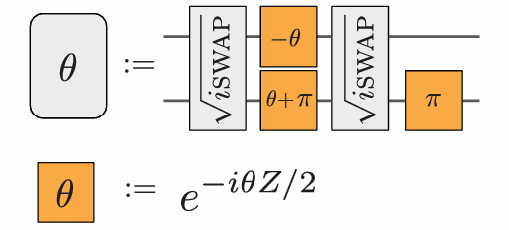
PART II · THEORY
SQISWAP and RZ exactly compile a real orbital rotation
$$R_{Z}\left(φ\right)=diag\left(e^{−iφ/2},e^{iφ/2}\right)$$
SQISWAP q[b],q[a]
RZ q[a],(π + θ)
RZ q[b],(-θ)
SQISWAP q[b],q[a]
RZ q[a],(π)
$$\sqrt{iSWAP}=\left(\begin{matrix}1 & 0 & 0 & 0 \\ 0 & 1/\sqrt{2} & i/\sqrt{2} & 0 \\ 0 & i/\sqrt{2} & 1/\sqrt{2} & 0 \\ 0 & 0 & 0 & 1\end{matrix}\right)$$
$$\text{single}\text{−}\text{particle} \text{action} \text{on} \left[a,b\right]: \left(\begin{matrix}cosθ & −sinθ \\ sinθ & cosθ\end{matrix}\right)$$
Every corrected circuit in this package emits explicit radians, eliminating exponent-versus-API ambiguity.
PART II · THEORY
08
Notes:
This slide maps the abstract Givens rotation to the actual native gate set. The key is not memorizing five lines, but verifying that their one-particle action is exactly a real orthogonal rotation.
[Sources]
- https://arxiv.org/abs/2004.04174
- https://pyqpanda-toturial.readthedocs.io/zh/latest/autoapi/pyqpanda/pyQPanda/index.html

Slide 9
PART II · THEORY
Two-mode interference maps coherence to occupation difference
Diagonal: measure Z directly
Off-diagonal: $π/4$ two-mode analyser
$$γ_{pp}=⟨n_{p}⟩=\sum_{b}^{​}{p}\left(b\right)b_{p}=\frac{1−⟨Z_{p}⟩}{2}$$
RZ q[a],(π/4)
RZ q[b],(-π/4)
SQISWAP q[b],q[a]
One setting returns all eight diagonal entries
$$Reγ_{ij}=\frac{⟨n_{a}^{′}⟩−⟨n_{b}^{′}⟩}{2}$$
$$\text{general} \text{phase} φ: Δn/2=Reγ_{ij}sin\left(2φ\right)+Imγ_{ij}cos\left(2φ\right)$$
PART II · THEORY
09
Notes:
Diagonal entries are occupations. Off-diagonal coherence is not directly visible in Z, so a number-conserving two-mode interferometer maps it to an occupation difference. The final equation is the mathematical basis of the angle-unit diagnosis.
[Sources]
- https://arxiv.org/abs/2004.04174

Slide 10
PART II · THEORY
Nine circuits recover the full real 8×8 1‑RDM
setting | orbital order P | physical edges | recovered γᵢⱼ
z | 0 1 2 3 4 5 6 7 | Z on all q | 00,11,…,77
p0_even | 0 1 2 3 4 5 6 7 | 01 23 45 67 | 01 23 45 67
p0_odd | 0 1 2 3 4 5 6 7 | 12 34 56 | 12 34 56
p1_even | 1 3 0 5 2 7 4 6 | 01 23 45 67 | 13 05 27 46
p1_odd | 1 3 0 5 2 7 4 6 | 12 34 56 | 03 25 47
p2_even | 3 5 1 7 0 6 2 4 | 01 23 45 67 | 35 17 06 24
p2_odd | 3 5 1 7 0 6 2 4 | 12 34 56 | 15 07 26
p3_even | 5 7 3 6 1 4 0 2 | 01 23 45 67 | 57 36 14 02
p3_odd | 5 7 3 6 1 4 0 2 | 12 34 56 | 37 16 04
Virtual swapping adds no measurement gates: relabel the modes, then recompile state preparation.
PART II · THEORY
10
Notes:
This table explains why only nine circuits are needed. Each even setting measures four pairs, each odd setting three; the four orderings cover all 28 off-diagonal entries.
[Sources]
- https://arxiv.org/abs/2004.04174

Slide 11
PART III · VISUALIZATION
Three views jointly validate structure, physicality, and finite-shot agreement
Raw 1-RDM heatmap
Natural occupations
Per-setting TV distance
reconstructed occupations and coherences
small excursions are compatible with 1000 shots
all nine settings lie inside their 95% envelopes
PART III · VISUALIZATION
11
Notes:
Read the three plots from left to right: the raw matrix, its eigenvalue spectrum, and setting-level distribution agreement. They test complementary parts of the same reconstruction.
[Sources]
- User-supplied circuit_result.zip (nine JSON files, 2026-07-28).
- Reproducible local analysis: code/h8_reproduction.py; results/diagnostics.json.
- Rubin et al., Science 369, 1084–1089 (2020), Supplementary Material, Appendix C.

Slide 12
PART IV · REPRODUCTION
H₂ closes the minimal quantum Hartree–Fock loop with two qubits
2
1
RHF/STO-3G · R=0.7414 Å · c=(1/√2,1/√2) · θ=π/4
X q[0] → G(θ)
Z setting → γ₀₀, γ₁₁
π/4 analyser → Re γ₀₁
qubits
particle per spin
2
−1.116684
measurement settings
RHF reference / Ha
One loop: prepare a Slater state → measure γ → evaluate $E_{RHF[γ]}$ with same-basis integrals.
PART IV · REPRODUCTION
12
Notes:
H₂ is the smallest complete molecular calibration. The quantum circuit encodes one spin sector, measures a 2×2 1-RDM, and the closed-shell functional restores the two-electron RHF energy.
[Sources]
- User-supplied quantum circuit res ver.zip and quantum circuit res.zip (2026-07-29).
- Reproducible local analysis: code/analyze_h2_simulator_wukong.py; results/h2/summary.json.
- H₂ RHF/STO-3G reference and Gaussian input: reference/ and gaussian/.
- Rubin et al., Science 369, 1084–1089 (2020), Supplementary Material.

Slide 13

PART IV · REPRODUCTION
Two measured distributions become the H₂ total energy in six steps
01
Read JSON
02
Fix conventions
03
Post-select
status · key/value · probability sum
1000 shots · key=q1q0
keep only N=1 outcomes 01/10
06
Evaluate energy
05
Physical/statistical
04
Reconstruct 1-RDM
same-geometry h, ERI, and $E_{nuc}$
rank-1 projection · bootstrap
diagonal populations + coherence
PART IV · REPRODUCTION
13
Notes:
The six steps follow the actual program order. The Gaussian/PySCF integrals, orthogonal orbital basis, geometry, and nuclear repulsion must match the quantum representation.
[Sources]
- User-supplied quantum circuit res ver.zip and quantum circuit res.zip (2026-07-29).
- Reproducible local analysis: code/analyze_h2_simulator_wukong.py; results/h2/summary.json.
- H₂ RHF/STO-3G reference and Gaussian input: reference/ and gaussian/.
- Rubin et al., Science 369, 1084–1089 (2020), Supplementary Material.

Slide 14
PART IV · REPRODUCTION
The zero-gate-noise simulator closes H₂ within chemical accuracy
$E_{raw}$=−1.116746 Ha and $E_{rank−1}$=−1.116107 Ha. both satisfy |ΔE|<1.594 mHa.
PART IV · REPRODUCTION
14
Notes:
The simulator Z distribution shows only 1000-shot variation and the analyser returns q0=1. Because both programmed gate-noise parameters are zero, this is not a robustness test at nonzero relaxation strength.
[Sources]
- User-supplied quantum circuit res ver.zip and quantum circuit res.zip (2026-07-29).
- Reproducible local analysis: code/analyze_h2_simulator_wukong.py; results/h2/summary.json.
- H₂ RHF/STO-3G reference and Gaussian input: reference/ and gaussian/.
- Rubin et al., Science 369, 1084–1089 (2020), Supplementary Material.

Slide 15
PART IV · REPRODUCTION
Particle-number post-selection cannot rescue the Wukong result
γ (N=1) | q0 | q1
q0 | 0.020 | −0.263
q1 | −0.263 | 0.980
54.2%
9.3%
0.259
P(N=1) · Z
P(N=1) · analyser
one-spin orbital F
rank-1: E=+0.181230 Ha.ΔE=+1297.9 mHa → FAIL
PART IV · REPRODUCTION
15
Notes:
The Wukong data undergo N=1 post-selection and then rank-1 projection. Neither step recovers the target: the analyser retains only about 93 effective shots and its conditional distribution is also wrong.
[Sources]
- User-supplied quantum circuit res ver.zip and quantum circuit res.zip (2026-07-29).
- Reproducible local analysis: code/analyze_h2_simulator_wukong.py; results/h2/summary.json.
- H₂ RHF/STO-3G reference and Gaussian input: reference/ and gaussian/.
- Rubin et al., Science 369, 1084–1089 (2020), Supplementary Material.

Slide 16

PART IV · REPRODUCTION
The same H₂ circuit passes in simulation and fails on Wukong
Relaxation-model simulator · PASS
Wukong 180 qubits · FAIL
relaxation model selected; 1Q/2Q noise parameters=0
Z: 0.484 / 0.516; analyser q0=1
$E_{raw}$=−1.116746 Ha
$E_{rank−1}$=−1.116107 Ha
+0.181230 Ha
rank-1 processed energy
+1297.9 mHa
error relative to RHF
$E_{ref}$=−1.116684 Ha; |Δ$E_{sim}$|<1.594 mHa, while |Δ$E_{Wukong}$|≫1.594 mHa
PART IV · REPRODUCTION
16
Notes:
Energy provides the clearest integrated metric. The simulator lies inside chemical accuracy, whereas the projected Wukong energy remains positive and far outside its bootstrap interval.
[Sources]
- User-supplied quantum circuit res ver.zip and quantum circuit res.zip (2026-07-29).
- Reproducible local analysis: code/analyze_h2_simulator_wukong.py; results/h2/summary.json.
- H₂ RHF/STO-3G reference and Gaussian input: reference/ and gaussian/.
- Rubin et al., Science 369, 1084–1089 (2020), Supplementary Material.

Slide 17
PART IV · REPRODUCTION
H₂ to H₈ changes scale, not the 1-RDM logic
01
System size
H₂: 2 modes/1 particle; H₈: 8 modes/4 particles
02
Measurement size
H₂: 2 settings; H₈: 1 diagonal + 8 interference settings
03
Experimental bottleneck
a deeper Givens network amplifies gate errors and leakage
Shared core: Slater preparation → γ reconstruction → physical projection → E_HF[γ] when integrals match.
PART IV · REPRODUCTION
17
Notes:
The mathematics does not change from H₂ to H₈; the Givens depth, number of measurement settings, and accumulated hardware error do.
[Sources]
- User-supplied quantum circuit res ver.zip and quantum circuit res.zip (2026-07-29).
- Reproducible local analysis: code/analyze_h2_simulator_wukong.py; results/h2/summary.json.
- H₂ RHF/STO-3G reference and Gaussian input: reference/ and gaussian/.
- Rubin et al., Science 369, 1084–1089 (2020), Supplementary Material.

Slide 18
PART IV · REPRODUCTION
Nine settings reconstruct the complete real H₈ 1-RDM
8
4
8 modes · 4 particles · X q[0..3] → Givens network
1 Z setting → 8 diagonal entries
4 permutations × even/odd analysers
→ 28 real off-diagonal entries
qubits
particles
9
36
complete settings
independent real entries
Each analyser is still a local π/4 interference.orbital permutations let eight circuits cover all 28 off-diagonal entries.
PART IV · REPRODUCTION
18
Notes:
One H₈ Z setting gives eight diagonal entries. Four orbital permutations, each with even and odd interference settings, cover all 28 real off-diagonal entries.
[Sources]
- Previously supplied H₈ nine-setting circuit_result data (2026-07-29).
- Reproducible local analysis: code/h8_reproduction.py; results/h8_previous/diagnostics.json.
- Rubin et al., Science 369, 1084–1089 (2020), Supplementary Material, Appendix C.

Slide 19
PART IV · REPRODUCTION
All nine H₈ simulator distributions match the corrected circuits
0.7696
0.0393
Mean DTV = 0.05336, inside the 1000-shot 95% interval [0.04654, 0.05896].reversed bit order gives 0.94177.
PART IV · REPRODUCTION
19
Notes:
All nine H₈ simulator distributions agree with the corrected explicit-radian circuits; the mean TV distance lies inside the ideal 1000-shot envelope.
[Sources]
- Previously supplied H₈ nine-setting circuit_result data (2026-07-29).
- Reproducible local analysis: code/h8_reproduction.py; results/h8_previous/diagnostics.json.
- Rubin et al., Science 369, 1084–1089 (2020), Supplementary Material, Appendix C.

Slide 20
PART IV · REPRODUCTION
The H₈ simulator reconstructs a near-rank-4 Slater 1-RDM
0.98 | 0.00 | 0.12 | -0.00 | -0.09 | 0.02 | 0.02 | -0.00
0.00 | 1.00 | 0.00 | -0.01 | 0.00 | 0.01 | 0.03 | -0.00
0.12 | 0.00 | 0.46 | -0.02 | 0.38 | -0.00 | -0.26 | -0.00
-0.00 | -0.01 | -0.02 | 0.50 | 0.01 | 0.35 | -0.01 | 0.34
-0.09 | 0.00 | 0.38 | 0.01 | 0.37 | 0.01 | -0.28 | 0.00
0.02 | 0.01 | -0.00 | 0.35 | 0.01 | 0.26 | 0.00 | 0.25
0.02 | 0.03 | -0.26 | -0.01 | -0.28 | 0.00 | 0.18 | -0.01
-0.00 | -0.00 | -0.00 | 0.34 | 0.00 | 0.25 | -0.01 | 0.24
4.000
0.057
−0.027 / 1.019
Tr γ · exact N=4 conservation
‖γ²−γ‖F · inside shot 95% CI
min / max natural occupation
Ideal 1000-shot CI for ‖γ²−γ‖F: [0.0345, 0.0784] · Slater F=0.996964
PART IV · REPRODUCTION
20
Notes:
The H₈ matrix preserves four particles and its idempotency error is compatible with finite shots; the projected Slater fidelity is 0.996964.
[Sources]
- Previously supplied H₈ nine-setting circuit_result data (2026-07-29).
- Reproducible local analysis: code/h8_reproduction.py; results/h8_previous/diagnostics.json.
- Rubin et al., Science 369, 1084–1089 (2020), Supplementary Material, Appendix C.

Slide 21
PART IV · REPRODUCTION
Conclusion: H₂ exposes the hardware gap; H₈ validates scalable measurement
01
H₂ simulator
energy error <0.6 mHa, but programmed gate-noise parameters are zero
02
H₂ on Wukong
severe leakage; post-selection and rank-1 projection still FAIL
03
H₈ simulator
nine-setting 1-RDM PASS; random basis rotation has no molecular-energy claim
PART IV · REPRODUCTION
21
Notes:
This edition separates three claims: H₂ simulator energy succeeds, H₂ hardware fails, and the H₈ simulator circuit/1-RDM reproduction succeeds.
[Sources]
- User-supplied quantum circuit res ver.zip and quantum circuit res.zip (2026-07-29).
- Reproducible local analysis: code/analyze_h2_simulator_wukong.py; results/h2/summary.json.
- H₂ RHF/STO-3G reference and Gaussian input: reference/ and gaussian/.
- Rubin et al., Science 369, 1084–1089 (2020), Supplementary Material.
- - Previously supplied H₈ nine-setting circuit_result data (2026-07-29).
- - Reproducible local analysis: code/h8_reproduction.py; results/h8_previous/diagnostics.json.
- - Rubin et al., Science 369, 1084–1089 (2020), Supplementary Material, Appendix C.

